Slide 1

African Philosophy
Joseph Eneji
Notes:
THE NATURE OF HUMAN BEINGS - MAN'S FREEDOM

Slide 2

Break out sessions:
Entering the debate
Is there an African Philosophy?
What characteristics should such a philosophy have?
What benefits or problems can there be in having an African Philosophy?
Who should carry out this activity.

Slide 3

Reviewing what philosophy is
Philos love and sophia wisdom
Study of the nature of the world (metaphysics)
Justification of a belief system (epistemology)
Conduct of life (ethics)
Notes:
Philosophy implies the process of questioning and the resutls of this interrogation. It is rational critical thinking of a more or less systematic kind about the general nature of the world (metaphyiscs or theory of existence), epistemology, ethics.
It is a process of asking questions and questioning answers in order to arrive at the truth.

Slide 4
The question of an African philosohy
Some say it is philosophy produced by African people focusing on an African world view using a distinctive African methodology.
Who is an African? What is an African world view? And what exactly is a distinctive African methodology?
Notes:
Some argue that Africa depicts its geographical location. The word is of phoenician origin and was first used by the romans to refer to the territory about the city of carthage. It was used to denote the land of sunshine, of black race and mostly the sub saharan regions of negroes. Others say it goes beyond location and designation.
World view: A person’s world view is the way they see and understand the world especially regarding issues such as politics, philosophy and religion. For instance, their christian world view, African world view, and so on.
Methodology: is a system of ways of doing, teaching, or studying something. Therefore, an African methodology connotes using the African standards (procedures) of doing, teaching or studying a particular phenomenon.

Slide 5
Definition
African philosophy can be formally defined as a critical thinking by Africans on their experiences of reality. Nigerian born Philosopher K.C. Anyanwu defined African philosophy as “that which concerns itself with the way in which African people of the past and present make sense of their destiny and of the world in which they live.”

Slide 6
Reasons in favor of an African Philosophy
There are other unwritten philosophies which are well recognised like the Pre-socratics, the Upanishads and Vedas (Indian philosophies)
Philosophic effort of traditional Africa has always been manifested in vital attitudes and has never had purely conceptual aims.
There’s a lot to learn from the traditions, tales, myths, and proverbs.

Slide 7
Influences against an African philosophy
Linnaeus (1758) argued that there was a hierarchy amongst human beings and so the African is closest to the lowest animals and is cunning, slow, negligent and ruled by practice.
Rational and logical thought is difficult for the African.

Slide 8
Influences from Darwin’s natural selection/ evolution.
"The various races, when carefully compared and measured, differ much from each other – as in the texture of hair, the relative proportions of all parts of the body, the capacity of the lungs, the form and capacity of the skull, and even the convolutions of the brain. But it would be an endless task to specify the numerous points of difference. The races differ also in constitution, in acclimatization and in liability to certain diseases. Their mental characteristics are likewise very distinct; chiefly as it would appear in their emotion, but partly in their intellectual faculties." (The Descent of Man, chapter VII)

Slide 9
Motivators for an African philosophy
The idea of African Philosophy was an attempt, among so many other attempts, to reaffirm our heritage and personality collapsing before Western bias. Africans wanted to accept and define their responsibility to assess the riches and promise of their culture and also to open dialogue with the West.
  Kanu Ikechukwu Anthony

Slide 10
Characteristics of such a philosophy- (Kanu Ikechukwu Anthony)
  African Philosophy ought to speak to African problems and situations.
  The person doing the philosophy must either come from Africa or be an African living in diaspora or involved in the life of the African people.

Slide 11
What then is African Philosophy
African philosophy is a philosophy that is grounded in African history, culture, tradition, and intellectual capacity towards challenging western views or narratives on African conception of reality.

Slide 12
four trends in modern African philosophy
1, Ethno philosophy
2, Philosophical sagacity
3, Nationalistic–ideological philosophy
4, Professional philosophy
  Henry Odera Oruka

Slide 13
The 4 trends in contemporary African Philosophy (H Odera Oruka)
1, Ethno-philosophy- beliefs, myths, folklores, proverbs in African cultures.
  It is communal rather than individual
  It is descriptive rather than critical analysis
  It counts on oral sources mainly
  Inaugurated by Placide Temple- Bantu Philosophy
  Attracted some criticism

Slide 14
Contd.
Ethno-philosophy is the practice of taking philosophical positions and arguments which were not originally written down or framed in terms of analytic philosophy, and re-describing them using the terminology and style of analytic philosophy.
It is basically anchored on cultural practices and oral tradition to reconstruct arguments and positions on African philosophy.
Keys proponents - Placid Tempels, John Mbiti

Slide 15
The 4 trends in contemporary African Philosophy (H Odera Oruka)
2, National-Ideological-The concern of this school was to combat colonialism and create political philosophy and ideology for Africa from the indigenous traditional system as a project of decolonization.
Philosophers here- Aimer Cisaire, Leopold Senghor, Kwame Nkrumah, Julius Nyerere

Slide 16
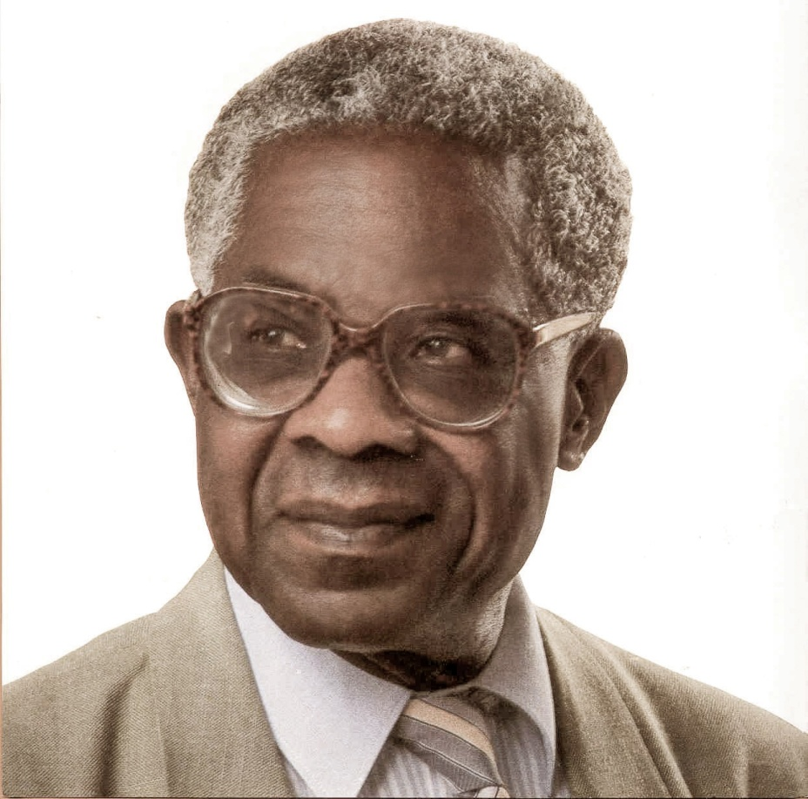
Aimer Cisaire
Notes:
poet, dramatist and politician: born Basse-Pointe, Martinique June 1913- April 2008. one of the founding fathers of Negritude, the black consciousness movement that sought to assert pride in African cultural values to counterbalance the inferior status accorded to them in European colonial thinking

Slide 17
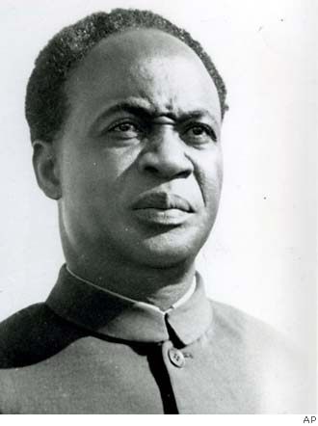
Kwame Nkrumah
Ghanaian politician and revolutionary.
Notes:
Economist, sociologist, philosopher, politician. Quotes
It is clear that we must find an African solution to our problems, and that this can only be found in African unity. Divided we are weak; united, Africa could become one of the greatest forces for good in the world. I am not African because I was born in Africa but because Africa was born in me.

Slide 18
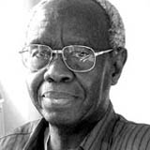


John Mbiti
Anglican priest, philosopher
He has written widely about theology and religion across the African continent.
He collaborated on a book of African proverbs, collected from across the continent.

Slide 19
Many others
George James- Stolen legacy
William Abraham- The mind of Africa
Jahnheinz Jahn- Muntu: African Culture and the western world.
Others- C. S. Momoh, Joseph Omoregbe, Lansana Keita, Olusegun Oladipo, Gordon Hunnings, Kwame Gyekye, M. A. Makinde, Emmanuel Edeh, Uzodinma Nwala, K. C. Anyanwu, R Ruch,

Slide 20
philosophical sagacity/ Conversation
Its main focus is to show that standard philosophical discourse existed and still exists in traditional Africa and can only be discovered through sage conversations ( special members of the community).
They hold that African philosophy can only be created by individual African philosophers who make use of the “usable past” and the depth of individual originality in finding solutions to contemporary demands.
Examples of philosophers here are Pantaleon Iroegbu, Innocent Asouzu, Bruce Janz, Jonathan Chimakonam, Ada Agada, Godfrey Ozumba and Jennifer Lisa Vest etc.

Slide 21
Professional philosophy
It is the view that philosophy is a particular way of thinking, reflecting, and reasoning, that such a way is relatively new to (most of) Africa, and that African philosophy must grow in terms of the philosophical work carried out by Africans and applied to (perhaps not exclusively) African concerns.

Slide 22
Professional School
Claims that African philosophy must have universal merit and thrive on the method of critical analysis and individual discursive enterprise. It is not about talking, it is about doing.
Some staunch members of this school include Kwasi Wiredu, Paulin Hountondji, Peter Bodunrin Lansana Keita, Peter Bodunrin, and Chukwudum B. Okolo, etc.

Slide 23
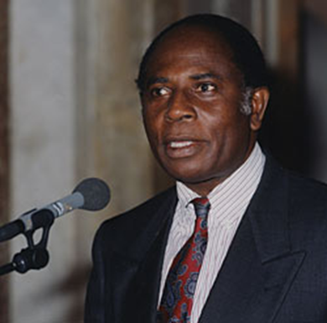
Kwasi Wiredu is a philosopher; his work is centred on the relationship between culture and philosophy. In particular, he is concerned with the philosophical conditions of an intercultural dialogue.
He points out that the value of the African tradition for the dialogue of cultures, demands a "conceptual decolonisation" and develops new concepts of ethics of consensus to promote democracy.
By decolonization, I mean divesting African philosophical thinking of all undue influences emanating from our colonial past”

Slide 24
Two other schools added
Literary/Artistic- e.g Ngugi wa Thiong’o, Wole Soyinka, Chinua Achebe, Okoy p’Bitek, Taban Lo Livong.
Hermeneutic- the analysis of African languages in order to find philosophical content.

Slide 25
Another classification by C.S Momoh & Azenabor
Theological school
African logical neo-positivist school
Purist school of thought
African ideological school

Slide 26
Theological school
Colonial scholars
Approach is from religion
  J. O. Sodipo
  K. C. Anyanwu
  W. F. Abraham
  C. B. Okolo
  J. S. Mbiti etc.
Most of them were evangelists
Sometimes called Christian Ethno-philosophers

Slide 27
African logical neo-positivism
Philosophers who are not excited about the claims, methodology and contents of African philosophy and consequently query them
Philosophers who deny the existence of an African philosophy
  P. O. bodunrin
  K. Wiredu
  P. Hountondji etc

Slide 28
African Logical Neo-Positivism Summary
Communal African philosophy is non-existent, it can only be individual
African Philosophy should be critical, reflective and rigorous discussions on problems of universal concern
African Philosophy should embrace a scientific orientation
African Philosophy should stay within framework of western philosophy
Crisis of relevance: science is a prerequisite for philosophy

Slide 29
Purist school
Fundamental questions similar to those in western philosophy are also raised and answered in African Philosophy (AP)
AP should be pure and undiluted
Academic philosophers can consider some African societies as their counterparts
    C. S. Momoh
    Barry Hallen
    J. O. Sodipo etc

Slide 30
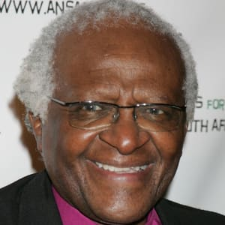
Desmond Tutu

Slide 31
Most of indigenous African philosophy is lived not written
Archbishop Desmond Tutu (1999):
“ A person with Ubuntu is open and available to others, affirming of others, does not feel threatened that others are able and good, for he or she has a proper self-assurance that comes from knowing that he or she belongs in a greater whole and is diminished when others are humiliated or diminished, when others are tortured or oppressed. ”

Slide 32
African philosophy in Life:
From a Nigerian perspective
Discuss 2 traditional concepts from your ethnic group that promote values with a critical analysis .
  They can be proverbs, poems, legends, taboos educational tools etc.
Do you know of any other concept that is similar in another ethnic group or African country? Or any western concept?
Share your findings in the class.

Slide 33
References
Bruce, B. Janz. (2007). African Philosophy. The Columbia Companion to 20th Century Philosophies. Columbia University Press. Retrieved from: https://www.researchgate.net/publication /297479261
Oyeshile, A. Olatunji. (2008). On Defining African Philosophy: History, Challenges and Perspectives. Humanity & Social Sciences Journal 3 (1): 57-64.

